Slide 1
CHILDHOOD OBESITY
Dr Anjumanara Omar

Slide 2
CONTENTS
Definition of obesity
Causes
Risk factors
Consequences
Prevention
Treatment

Slide 3
DEFINITION
Excessive fat in the body
BMI ( Body Mass Index) is a screening tool for measuring obesity
BMI= Weight in kg
(Height in m)2
BMI measures body fatness directly

Slide 4
Recommendation by CDC
Use BMI percentile when measuring bodies of children between 2-20years
CDC defines overweight in children as BMI at or above 85th centile and less than 95th centile
CDC defines obesity in children as BMI at or above 95th centile

Slide 5
OBESITY IN ADULTS
Obese – BMI> 30
Overweight – BMI=25-30

Slide 6
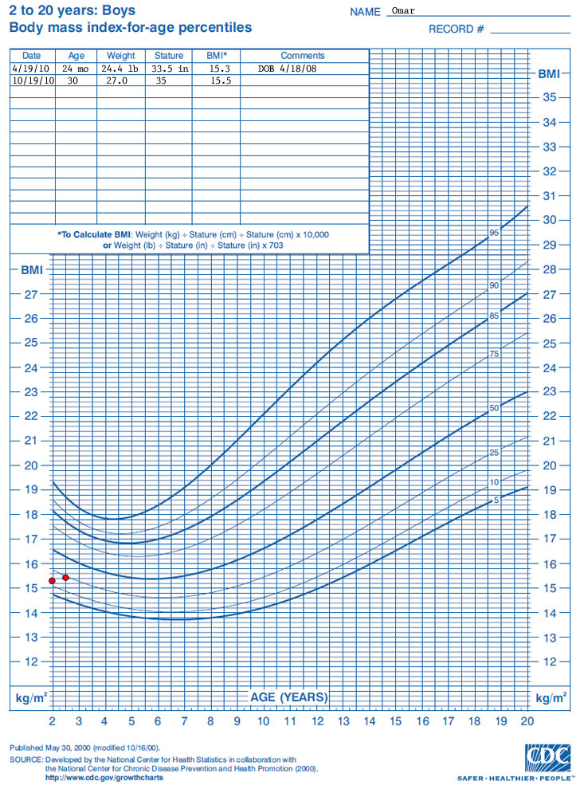
CDC BMI CHART FOR BOYS

Slide 7
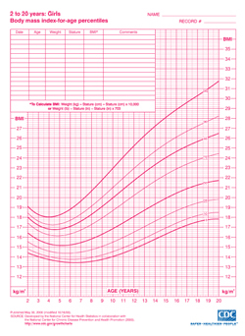
BMI CHART FOR GIRLS

Slide 8
CLASSIFICATION OF OBESITY
Idiopathic
Endocrine: short
Hypothyroidism
Hypercortisolism
Growth hormone deficiency
Genetic
Prader-Willi
Turner

Slide 9
CLASSIFICATION
CNS conditions: hypothalamic damage
Medications
Glucocorticoids
Phenothiazines
Lithium
Amytryptiline
Estrogen/progesterone

Slide 10
CAUSES
Consuming more energy from food and beverages
Energy imbalance is a key factor behind high rates of obesity

Slide 11
Factors contributing to obesity
Genetics
Metabolism
Community and neighborhood design and safety
Short sleep duration

Slide 12
Risk factors associated with obesity
Sugary beverages
Snack food
Portion size
Activity level
Environmental factors
Socio-cultural factors
Family factors
Psychological factors eg depression

Slide 13
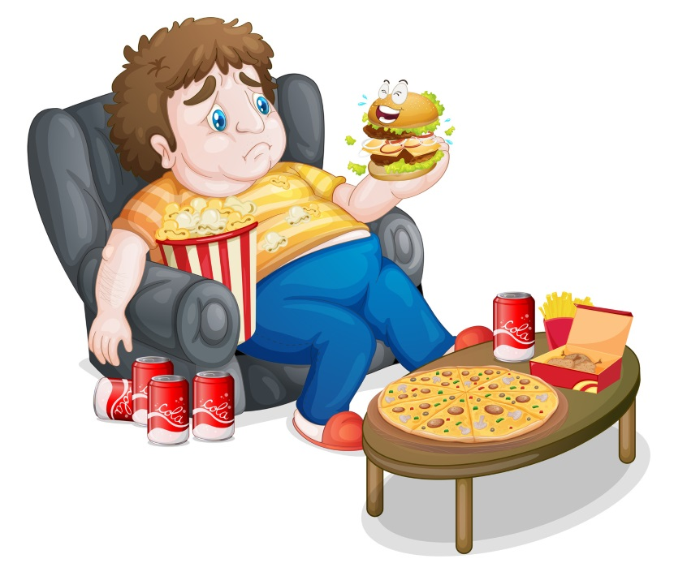

Slide 14
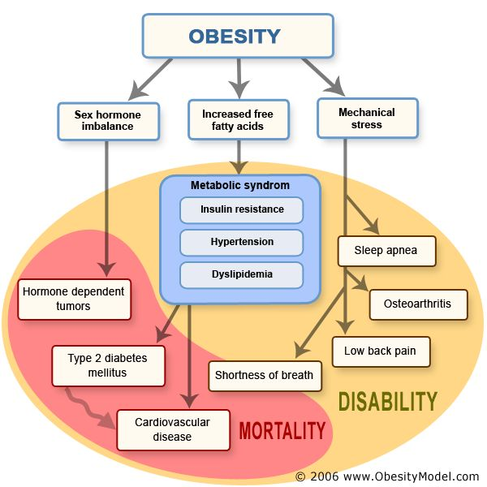
MEDICAL CONSEQUENCES

Slide 15
Skin conditions
Menstrual abnormalities
Orthopedic problems

Slide 16
Socio-emotional consequences
Teased and bullied for their weight
Negative stereotypes
Discrimination
Low self esteem
Low self confidence
Negative body image
Poor academic performance

Slide 17
IMPORTANT
In the long term, a child with obesity is more likely to have obesity as an adult

Slide 18

PREVENTION

Slide 19
POST CONCEPTION
Routine prenatal care
Advocate appropriate weight gain during the pregnancy
LGA infants and infants of diabetic mothers have higher rates of subsequent obesity
SGA infants also at higher risk
Hediger ML et: Pediatrics104:e33, 1999

Slide 20
PREVENTION INFANCY
Advocate for continued breast feeding
The duration of breastfeeding is inversely associated with the risk of overweight
Harder T. Am J Epidemiol. 2005;162(5):397-403
Avoid over feeding formula feed infants
Monitor growth curve including weight for length curve
Excessive weight gain associated obesity
Taveras EM et al. Weight status in the first 6 months of life and obesity at 3 years of age. Pediatrics 2009;123:1177-1183

Slide 21

DIETARY PREVENTION
Cornerstone of treatment
Weight loss determined by #calories consumed relative to expended
Healthy diet
55% carbs
30% fat
15% protein
Avoid fad diets

Slide 22


Slide 23
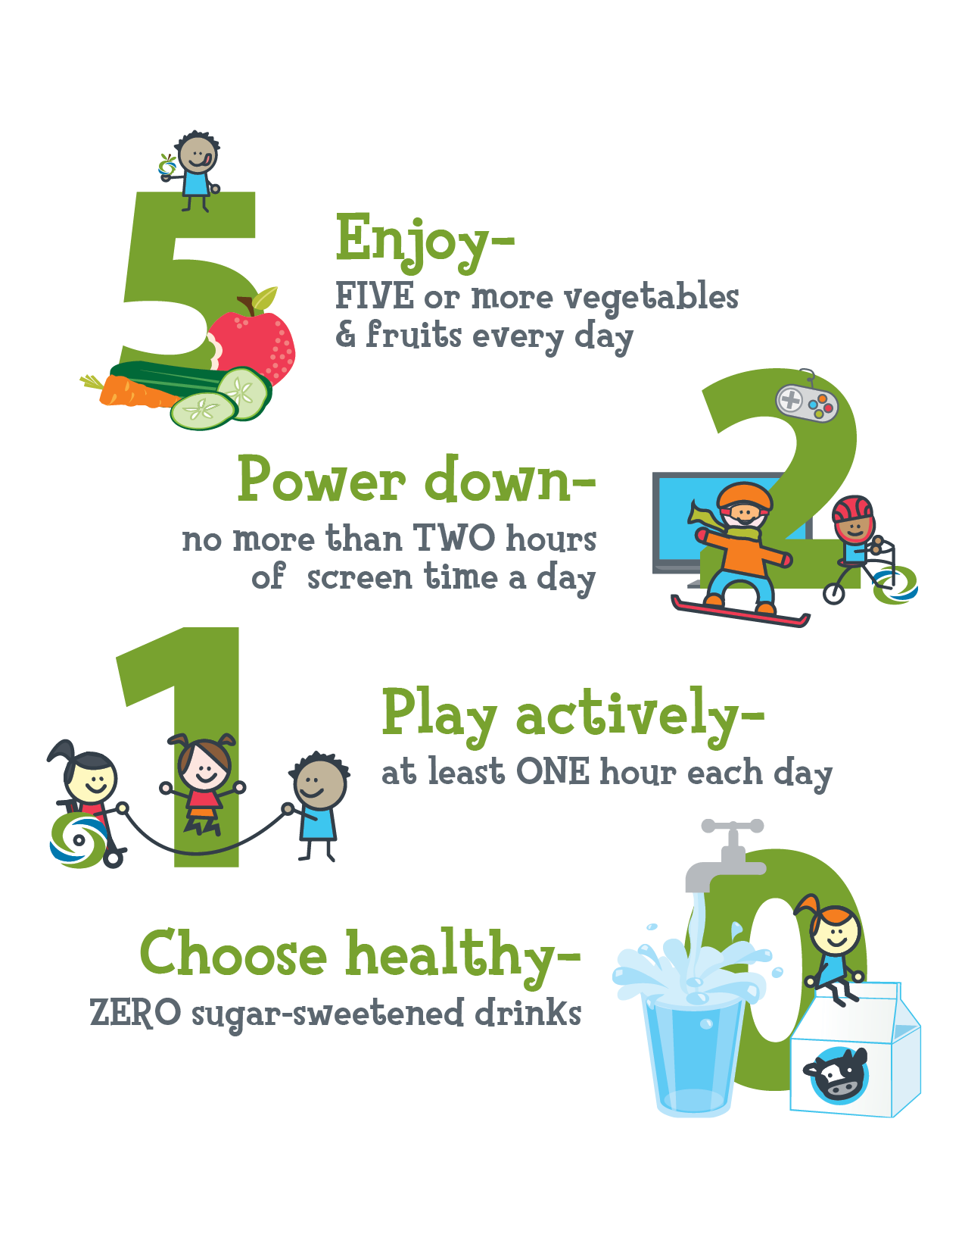

Slide 24
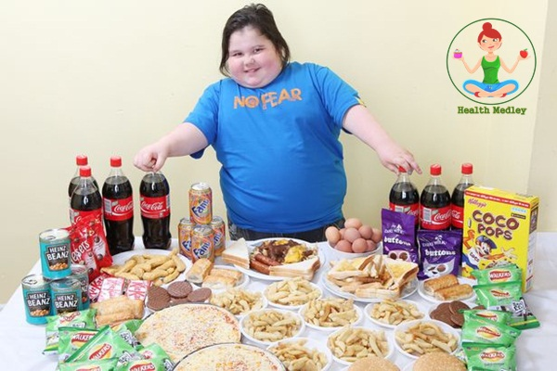
FORBIDDEN FOODS

Slide 25
TREATMENT
Treat Glucose intolerance and insulin resistance
Treat Type 2 DM
Manage cardiovascular symptoms
Treat sleep apnea and asthma
Manage psycological issues-involve psychologist

Slide 26
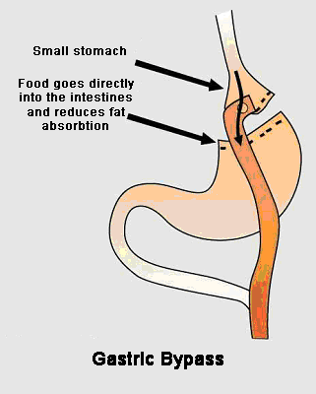
Gastric bypass
Gastic plication
Gastric banding
Jejuno-ileal bypass no
longer performed
Not routine for children

Slide 27
CHALLENGES
Denial by family members and caregivers
Interventions in clinical settings through clinician-family members
Strategies to bridge clinical efforts with support outside of the clinical setting
Innovations in the integration of web, mobile or social media into clinical programs for childhood obesity
Interventions focusing on obese or diabetic pregnant moms

Slide 28
